Slide 1


Course : 23CSC04- Principles Of Compiler Design
Module I : Lexical Analysis And Syntax Analysis Topic : Regular Expression to NFA
www.skcet.ac.in

Slide 2
SESSION OUTCOMES
At the end of the session, the learner would be able to,
Convert a Regular Expression to an equivalent NFA.
Convert a NFA to equivalent DFA.

Slide 3
Lexemes- Lexical analyser reads the stream of characters of the source program, and groups them into meaningful sequences, called lexemes.
Regular Expressions (R.E)
- a convenient notation for
representing lexeme patterns.
R.E. can be transformed into NFA and then into DFA.
NFA & DFA can be used as input to a driver program that simulates these automata and uses them as a guide to determine the next token.

Slide 4
ROLE OF RE, NFA, DFA IN LEXICAL ANALYSIS
NFA
Regular expressions
DFA
Lexical Specification
Table-driven Implementation of DFA

Slide 5
For each kind of reg-exp, an NFA notation is defined
Notations:
Thompson’s Construction of NFA from Regular Expression
M
NFA for rexp M
ε
For ε
a
For input a

Slide 6
For AB
ε
A
B
For A + B
ε
ε
A
ε
ε
B

Slide 7
For A*
ε
ε
A
ε
ε

Slide 8

Consider the regular expression
(1+0)*1
𝜺
1+0
1
𝜺
𝜺
𝜺
𝜺
0

Slide 9
(1+0)*
𝜺
1
𝜺
𝜺
𝜺
𝜺
𝜺
𝜺
0
𝜺

Slide 10



(1+0)*1
𝜺
1
𝜺
𝜺
𝜺
1
𝜺
𝜺
𝜺
0
𝜺

Slide 11
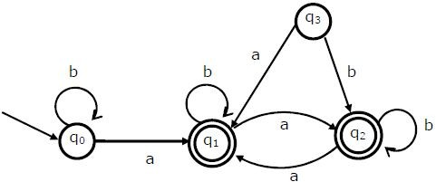
Try this!!
The language accepted by the automaton is given by,
b*ab*ab*ab*
(a+b)*
b*a(a+b)*
b*ab*ab*

Slide 12
a+
(a+b)*

Slide 13
NFA to DFA

Slide 14
EPSILON CLOSURE (ε-closure):
For any state, set of all states that can be reached following the epsilon-moves.
States of DFA= All possible subsets of NFA.
Start state of DFA = Epsilon closure of Start state of NFA
Final States of DFA = Any state that has at least one of the final state of the NFA.
A transition from state X to Y, on an input symbol ‘a’ is possible if, Y = ε( a(X)),
where a(X) = set of all states that can be reached from X on reading ‘a’

Slide 15
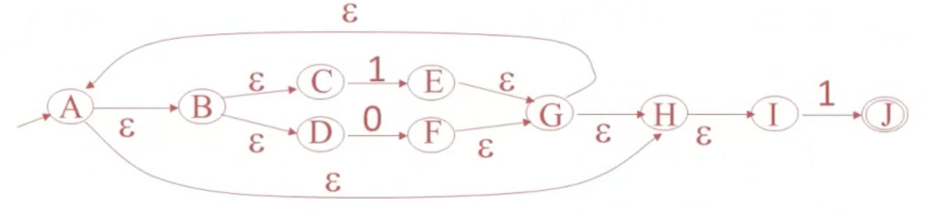
Convert this NFA to DFA

Slide 16

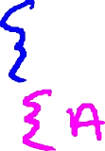











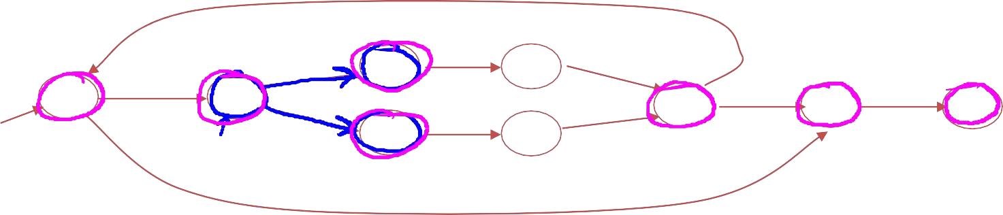
Epsilon closure- e.g.
ε
ε ε
1
ε
ε
C D
ε
E F
1
A
B
G
H
I
J
ε
ε
ε
0
Alex Aiken

Slide 17
Subset Construction:
1. Find the start state of DFA.
= ε-closure(A)= (ABCDHI)

Slide 18

2. Find the possible transition from this start state, for each input symbol.
Transitions on 0:
0(ABCDHI) = (F)
ε-closure(F)=(FGHIABCD)
Transitions on 1:
1(ABCDHI) = (EJ)
ε-closure(EJ)=(EGHIABCD)
These two subsets of states(given in red) will be states in the DFA

Slide 19
Find the possible transition from these two new subsets, for each input symbol.
Possible Transitions for (FGHIABCD) Transitions on 0:
0(FGHIABCD) = (F)
ε-closure(F)=(FGHIABCD)
This state is already part of the DFA.
Transitions on 1:
1(FGHIABCD) = (EJ)
ε-closure(EJ)=(EGHIABCDJ)
This state is already part of the DFA.

Slide 20
Possible Transitions for (EGHIABCD) Transitions on 0:
0(EGHIABCD) = (F)
ε-closure(F)=(FGHIABCD)
This state is already part of the DFA.
Transitions on 1:
1(EGHIABCDJ) = (EJ)
ε-closure(EJ)=(EGHIABCDJ)
This state is already part of the DFA.

Slide 21
No new states are found. So subset construction has converged.
States in Equivalent DFA:
(ABCDHI) = Start state
(FGHIABCD)
(EGHIABCDJ) = Final state, as it contains the final state, J of the given NFA.

Slide 22
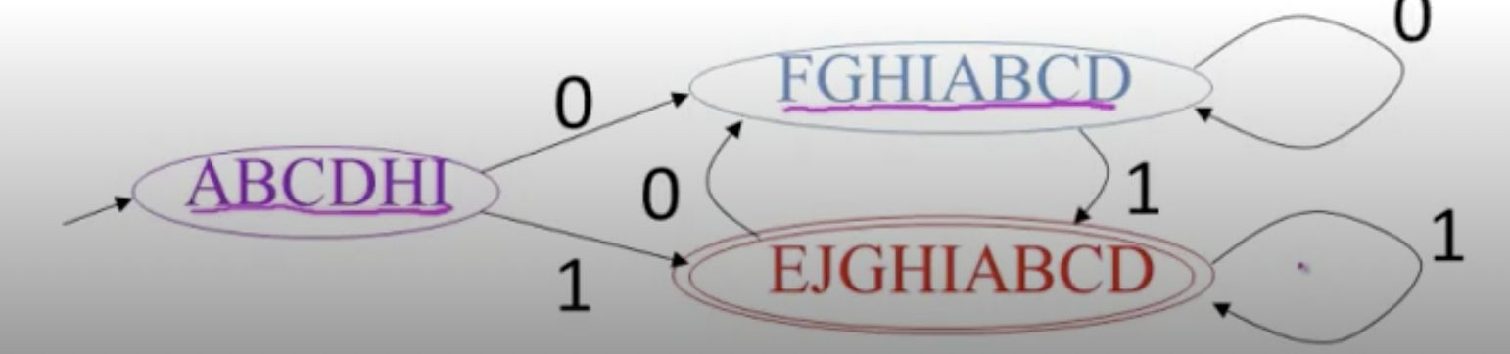
Equivalent DFA

Slide 23
In Conclusion:
Regular expressions patterns.
are used to represent
Any regular expression can be converted to NFA, which recognises the same language, as defined by the regular expression.
Any NFA can be converted to DFA, whose language is the same as that of the NFA.

Slide 24


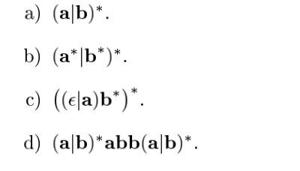

Convert the Regular expressions to
NFA & then to DFA
FOR YOU, TO THINK & SOLVE!!
www.skcet.ac.in

Slide 25


Supplementary Learning Content
Follow the Links, to continue Learning!!
Chapter 3.7

Slide 26


Coming Up: Syntax Analysis. Role of the parser.
Thank You!!

